Slide 1
AI AUTOMATION & THE RISE OF HUMAN SOFT SKILLS
Why emotional intelligence will define the next era
“The future isn’t human vs. machine – it’s human through the machine.”
ANUSHKA KAWALE
JUNE 2025 BATCH

Slide 2
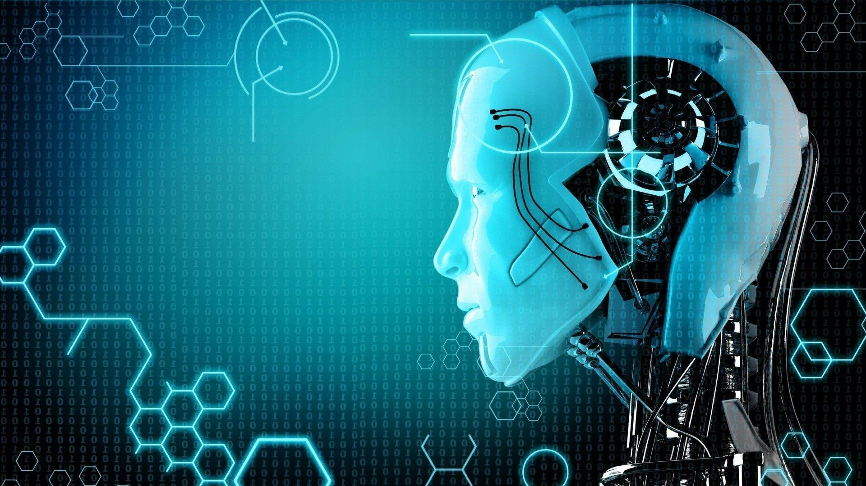
THE MORE WE AUTOMATE, THE MORE WE NEED TO FEEL
AI and automation are growing exponentially they are transforming jobs and industries
The more tasks machine do, the more human touch we crave
Emotional connection is becoming a premium in an automated world

Slide 3
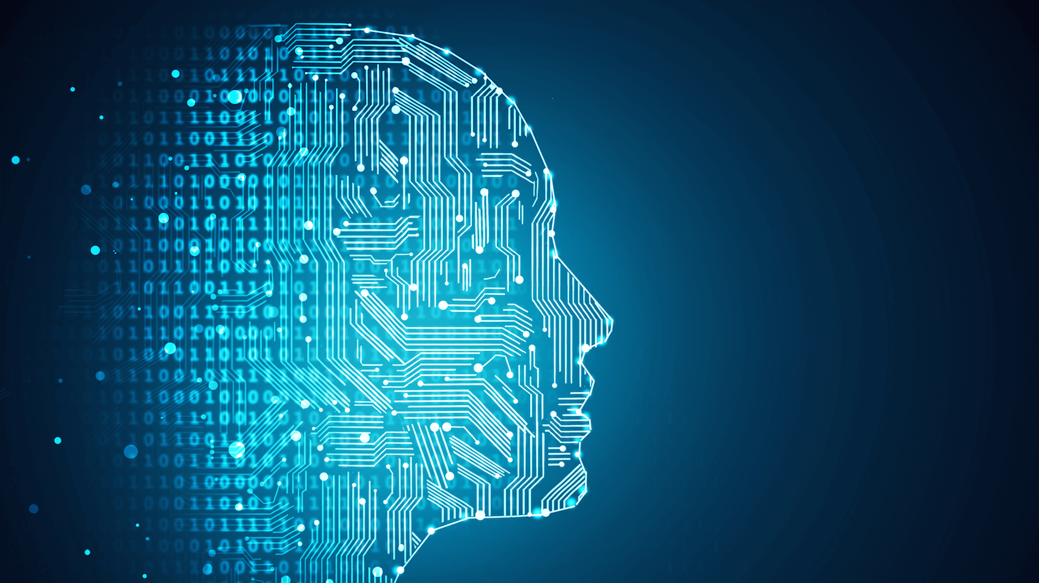
WHAT MACHINES CAN’T DO
Machines Excel at : Data, speed, precision, repetitive tasks
Machines Lack : Emotion, morality, intuition, cultural nuance
Humans excel at : Creativity, empathy, values and storytelling

Slide 4
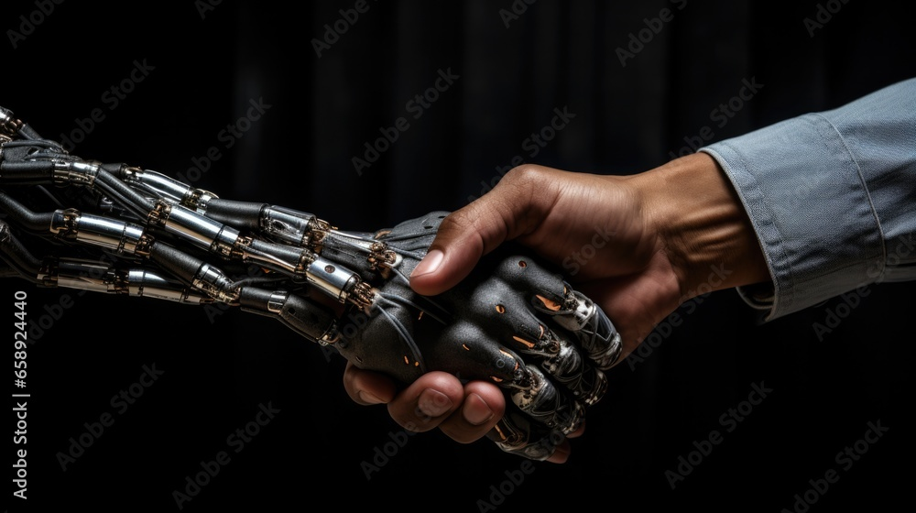
WHEN AI AND HUMANS (SOFT SKILLS) WORK TOGETHER
AI offers scale and intelligence, but not warmth or ethics
Humans soft skills make technology more ethical, inclusive, and trustworthy
Example : AI gives insights, human apply them with empathy and ethics

Slide 5


CASE STUDY – EMOTIONAL INTELLIGENCE AT WORK
REAL IMPACT OF SOFT SKILLS
Google’s Project Oxygen – Soft skills ranked higher than tech skills in best performing managers
IBM found that top executives valued people skills over technical expertise
Salesforce trains empathy as a core part of leadership development

Slide 6
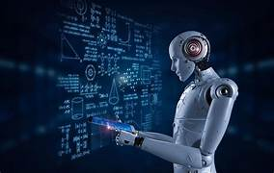
THE FUTURE DEMANDS DEEPER EMOTIONAL CAPABILITIES
EMOTIONAL AGILITY – Handling emotions under stress
MORAL IMAGINATION – Making ethical decisions with limited data
DEEP LISTENING – Understanding what’s not said
CULTURAL INTELLIGENCE – Working across values, traditions and backgrounds

Slide 7
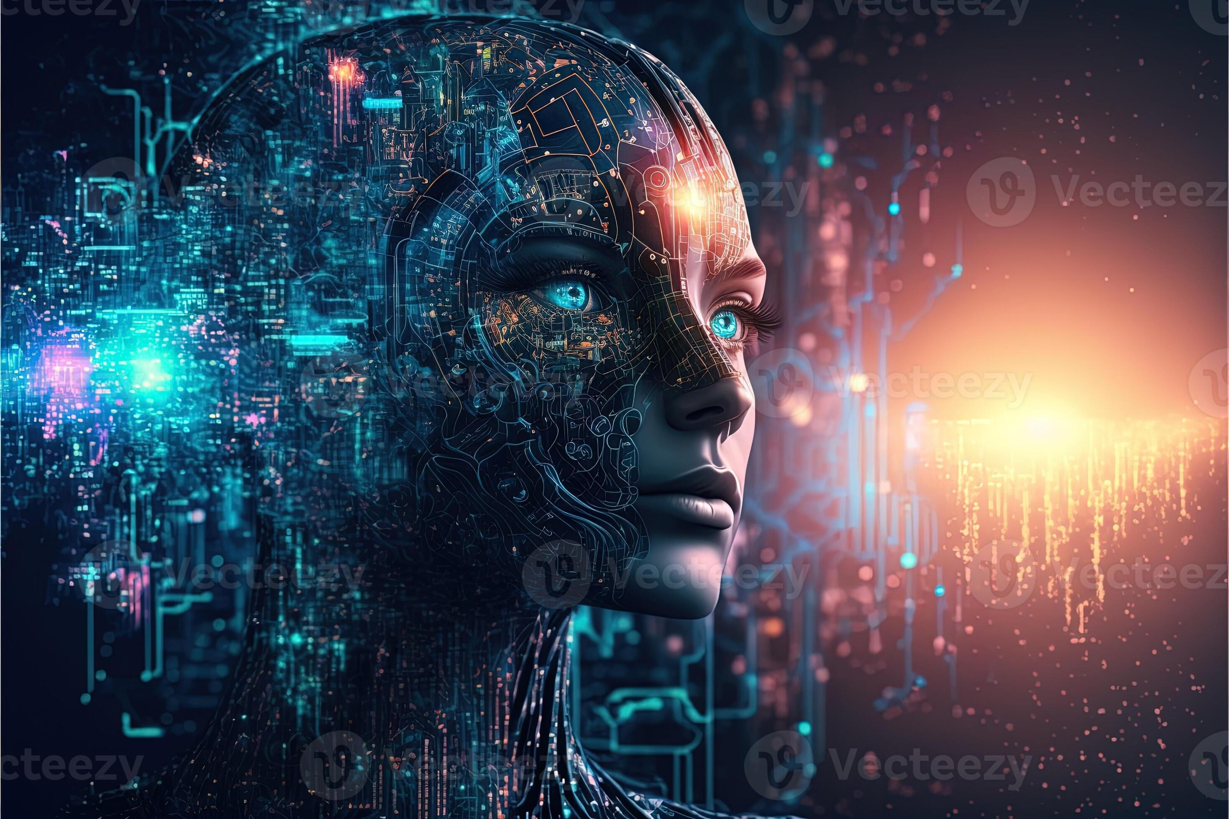
WHEN AI FAILS WITHOUT SOFT SKILLS
AI has misinterpreted grief, resulting in cold customer service
Resume screening AI showed racial/gender bias when not guided by human fairness
Predictive systems have punished rather than helped people in need

Slide 8
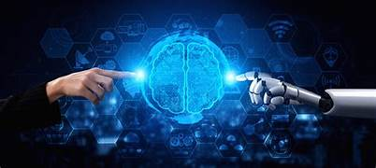
THE HUMAN – AI PARTNERSHIP
AI assists with tasks, humans bring judgment and empathy
Together, we build systems that are efficient and compassionate
The real future is Human + Machine, not Human Vs. Machine
Example : AI in healthcare helps diagnose, but human doctors provide comfort

Slide 9
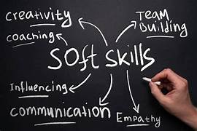
BUILDING SOFT SKILLS IN THE AGE OF AI
Reflect on emotions daily through journaling or mindfulness
Practice active, non – judgemental listening
Get feedback and grow from discomfort
Step into roles that challenge emotional strength (leadership skills, mentoring, leading )

Slide 10
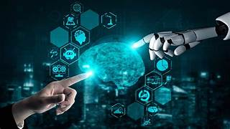
BALANCED INTELLIGENCE IS THE FUTURE
HUMAN INTELLIGENCE (HI) : Creativity, logic, innovation
EMOTIONAL INTELLIGENCE (EQ) : Trust, ethics, compassion
ARTIFICIAL INTELLIGENCE (AI) : Speed, Prediciton, Automation

Slide 11

FINAL REFLECTION – THE BEST OF BOTH WORLDS
Let AI handle repetition, data and prediction
Let humans bring creativity, compassion and ethical judgement
Soft skills are not a substitute for technology – they’re the soul behind it

Slide 12
THANK YOU

